Slide 1






Texas Instruments Foundational Technology Research Program on Millimeter Wave and High Frequency Microsystems
42 Month Review
August 6th, 2021

Slide 2
Texas Instruments Foundational Technology Research Program on Millimeter Wave and High Frequency Microsystems
42 Month Review
08:20-08:30 AM Check-in
08:30-09:00 AM Center Progress/Overview
09:00-09:50 AM 0.41-THz CMOS-based Short-Range Imager for Industrial Applications
09:50-10:30 AM Code-Modulated Embedded Test of Multifunctional Arrays
10:30-10:40 AM Break
10:40-11:20 AM Packaging and Material Spectroscopy to Support Terahertz Microsystems
11:20-12:00 PM Infrared Detection Using Structures in Foundry CMOS
12:00-12:10 PM Set up for lunch
12:10-12:50 PM 170GHz – 260GHz Wideband PA and LNA Design in Silicon
12:50-01:30 PM Advanced Algorithms for Terahertz Sensing and Recognition
01:30-02:00 PM Discussion

Slide 3
University Logo
Title of Task
42 Month Review
August 6th, 2021

Slide 4
IR Detection Using Structures in CMOS (First Mandatory Slide)
Description: This project investigates techniques to implement infrared imagers by using electronic detectors fabricated in foundry CMOS that do not need thermal isolation. The read out electronics will be co-integrated with the detectors and the combination will be demonstrated in a package.
Goals: This project seeks to lower the cost of infrared imagers by demonstrating affordably packaged electronic detectors fabricated in foundry CMOS. This project seeks to open up new market opportunities for silicon integrated circuits industry as well as enabling wider uses of IR imaging technology.
Principal Investigator: Kenneth K. O (University of Texas, Dallas)
Students Current Status
Sandeep Kshattry Ph.D. (12/17)
Behnam Pouya Ph.D. (04/20)
Ahsan Ghauri To start in 01/18
Liaisons:

Slide 5
Plans and Deliverables (Year 4) (2nd to the last Mandatory Slide)
Milestones
Fabricate various junctions (Tape out next week).
Measure and model the junctions including noise performance (May 31st, 2018).
Design 20-THz detectors using various junctions (July 31st, 2018).
Deliverables
Models of junctions (May 31st, 2018).
Report on the design of 20-THz detector (August 31st, 2018).
.

Slide 6
IR Detection Using Structures in CMOS (Last Mandatory Slide)
 | Year 1 | Year 2 | Year 3 | Year 4
Milestones | -Fabricate various junctions, -Measure and model the junctions including noise performance. -Design 20-THz detectors using various junctions. | -Characterize the detector performance. -Fabricate detectors and arrays with reduced impact of low frequency noise. -Evaluate the impact of packaging on detector performance. | -Fabricate and measure 20 and 40-THz detectors and arrays with an antenna with a larger aperture. -Fabricate, measure, and model alternate detection device test structures. Integrate the detector array in a package with a lens. | -Fabricate and measure 40-THz detectors with an on-chip metamaterial reflector. -Evaluate the packaged detector. Improve meta-material reflector.
Deliverables | -Models of junctions -Report on the design of 20-THz detector | -Report on measurement results of 20-THz detector -Report on performance change due to packaging. | -Report on measurement results of detector array with an increased aperture -New models for junctions. -Report on performance change due to packaging with a lens. | -Report on measurements of 40-THz detector array with an on-chip reflector.

Slide 7
Major Accomplishments (4th 6 months)
Developed techniques to measure temperature dependence of dielectric properties. (Mark Lee)
Continue to improve the measurement techniques for low loss-tangent materials at 1-100 GHz. Starting to investigate ring resonator techniques. (R. Henderson)
Established system and methodology for reliable experimental data collection using TI mmWave radars. Improving the synergy between pre-processing and machine learning blocks. (M. Torlak)
Starting to work on dynamic gesture recognition using data sets from TI mmWave radars. (Y. Makris)
Observed polarization dependence of output voltage of detector using Schottky diode at ~20 THz (18.2-21.5 THz). (K. O)
Demonstrated a 410-GHz transceiver imaging pixel occupying an area of 374×380µm² (W. Choi)
Preparing for tapeout of PA using IHP 130-nm SiGe HBT technology. (A. Babakhani)
Code-modulated test and calibration developed and validated on a 10-GHz array, showing ±0.4dB gain and ±3o phase accuracy. (B. Floyd)

Slide 8
Major Accomplishments – BULLET POINT
Investigated data-driven approach for high resolution envelope imaging. Developed THz imaging simulator and imaging pipeline for new THz chip.

Slide 9
Outline
Mail inspection scanner
System Design
Early Results + Analysis
SAR Resolution Improvement using Machine Learning
2D SAR Imaging
Proposed Solution
Results
3D SAR Imaging
Results
Empirical Results
Dataset Generation
Synthetic Data
Real SAR Images
THz Imager

Slide 10

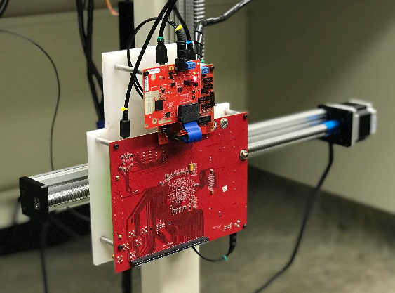
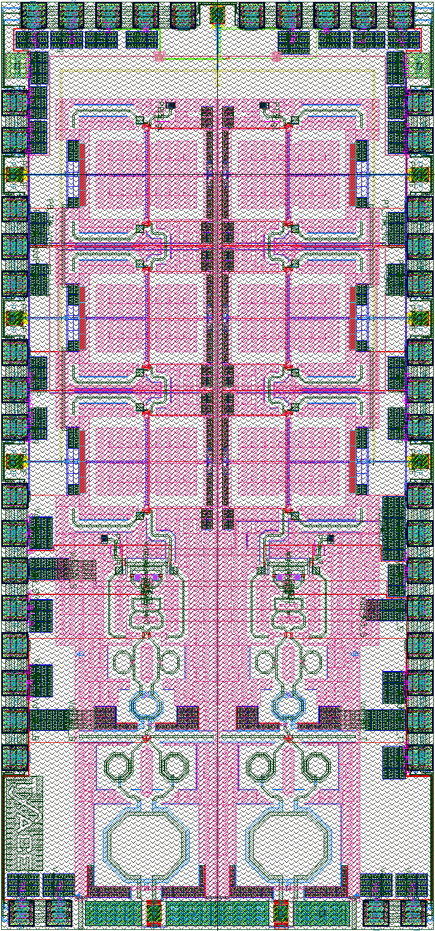

Mail Inspection Scanner
Mail inspection scanner
Requires downward-facing imaging system
Current system is vertically oriented
Built new, versatile system
1m
TI 77GHz mmWave Radar
Resolution scales with carrier frequency

Slide 11
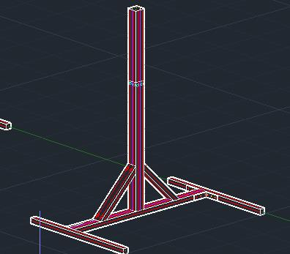
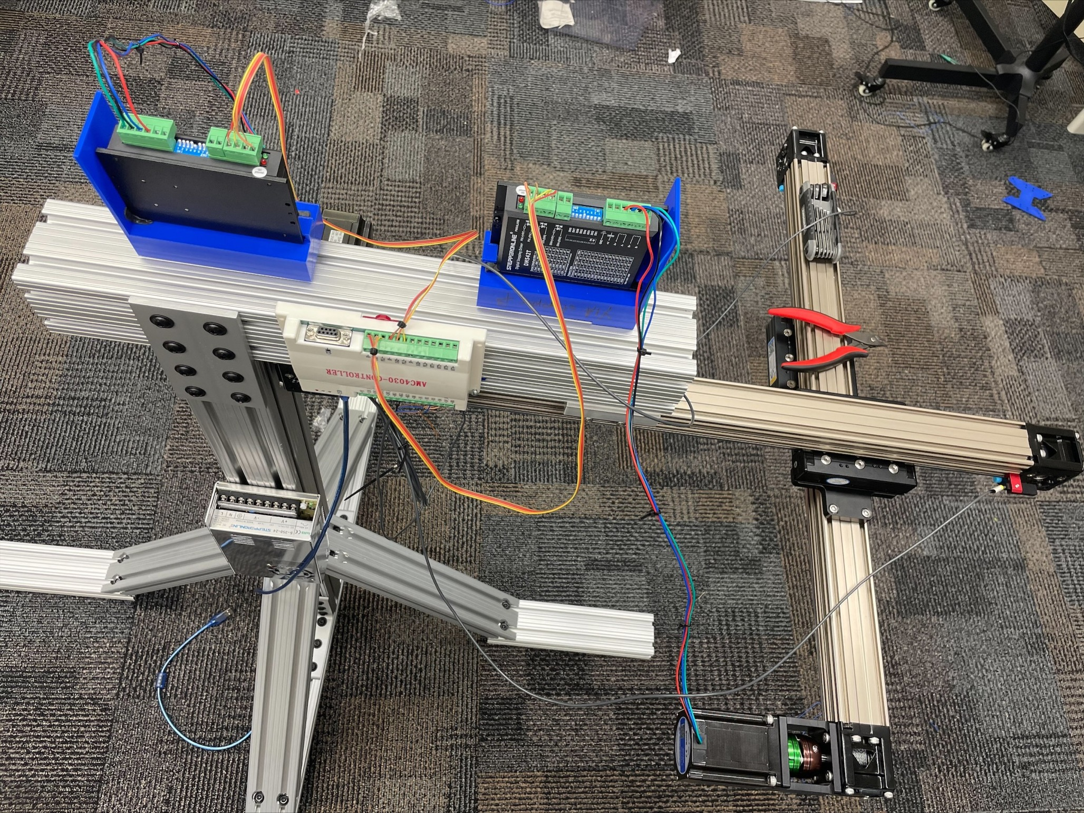
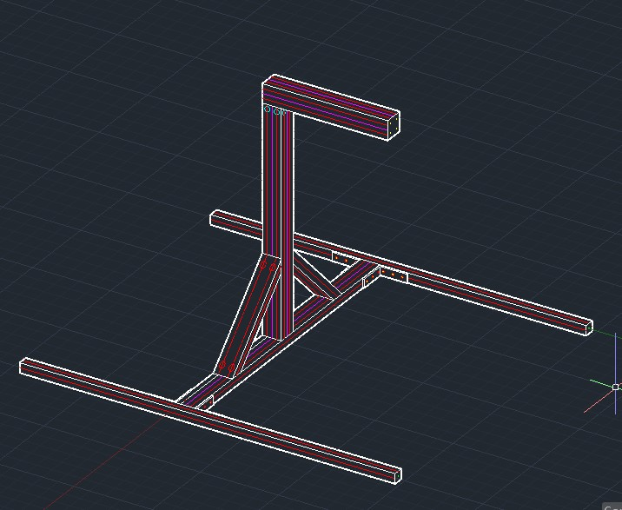
System Design
Dual mode scanner
Vertical or horizontal orientation
Simulates mail inspection scanner
TI 77GHz mmWave radar, currently
THz imager coming

Slide 12
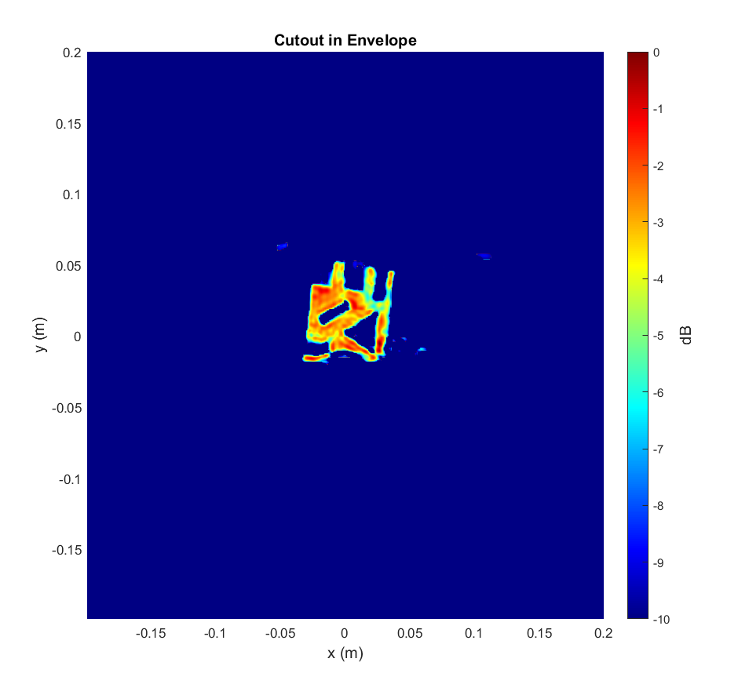
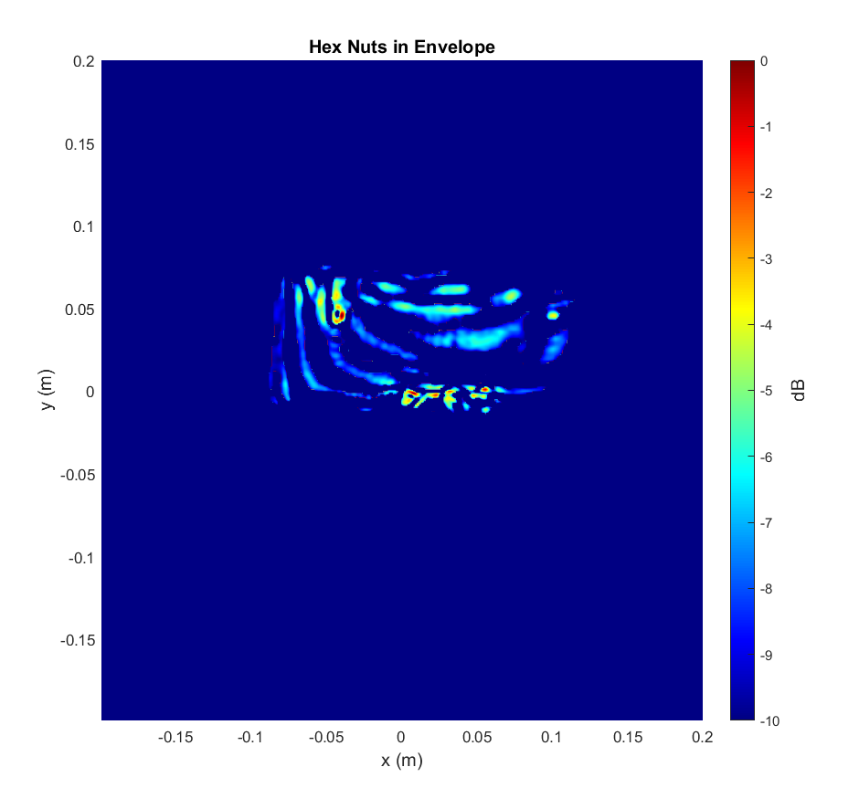
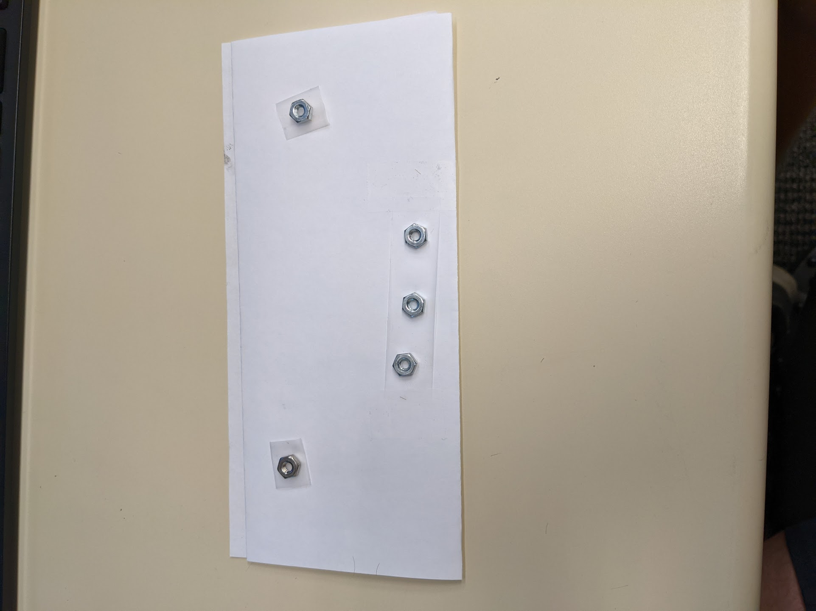
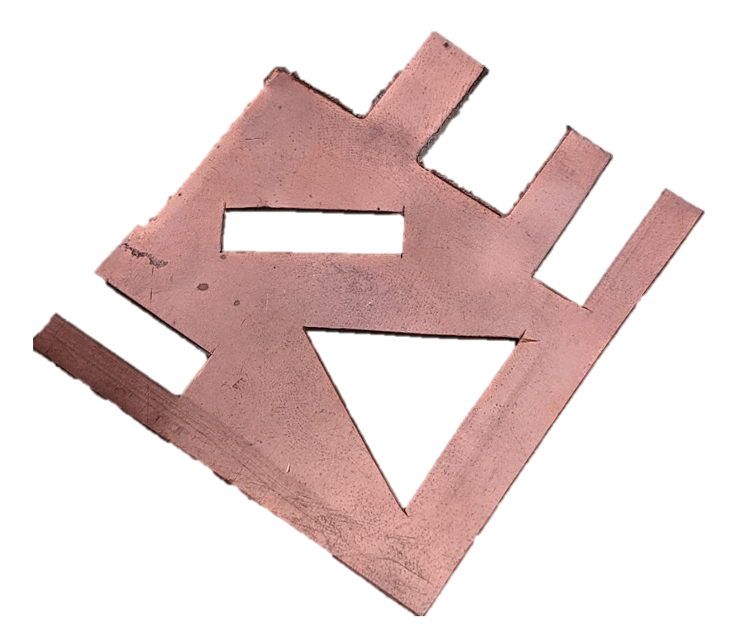
Early Results + Analysis
High Reflectivity Target
Strong reflection
Easily identifiable
Low Reflectivity Target
Weak reflection
Somewhat obscured by interferers
TI 77GHz mmWave Radar
Resolution scales with carrier frequency

Slide 13
Early Results + Analysis
Higher resolution can improve detection performance and image quality

Slide 14
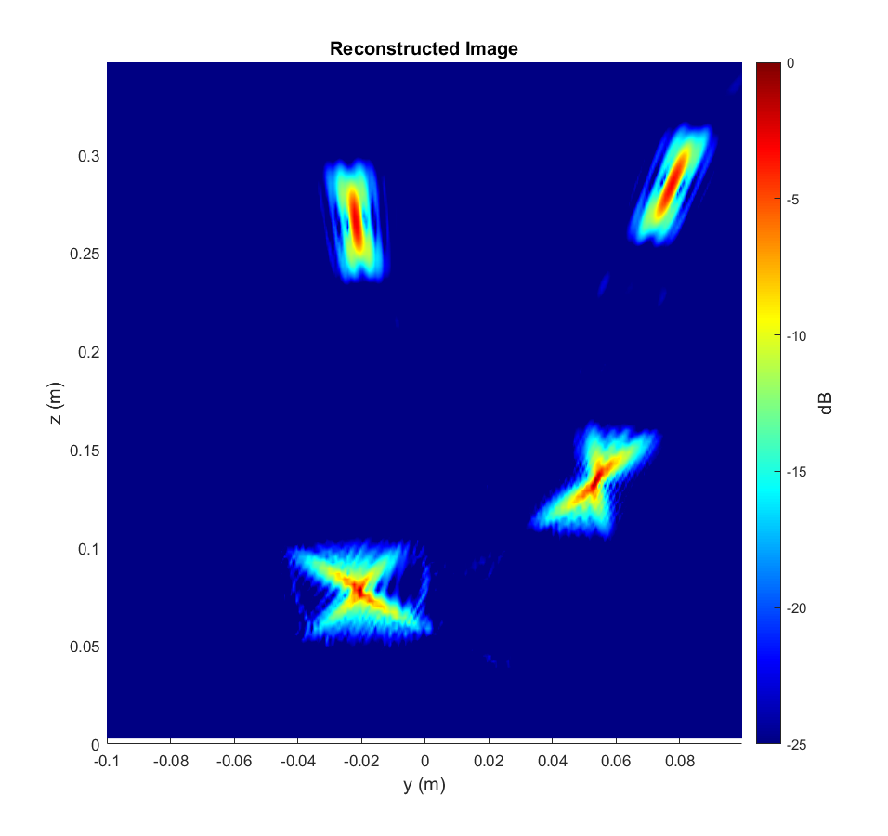
SAR Resolution - Motivation
Motivation for higher resolution
SAR images are blurry and distorted
Limited bandwidth, aperture effects, etc.
Can we improve the resolution of the recovered image? (“Denoising”)

Slide 15
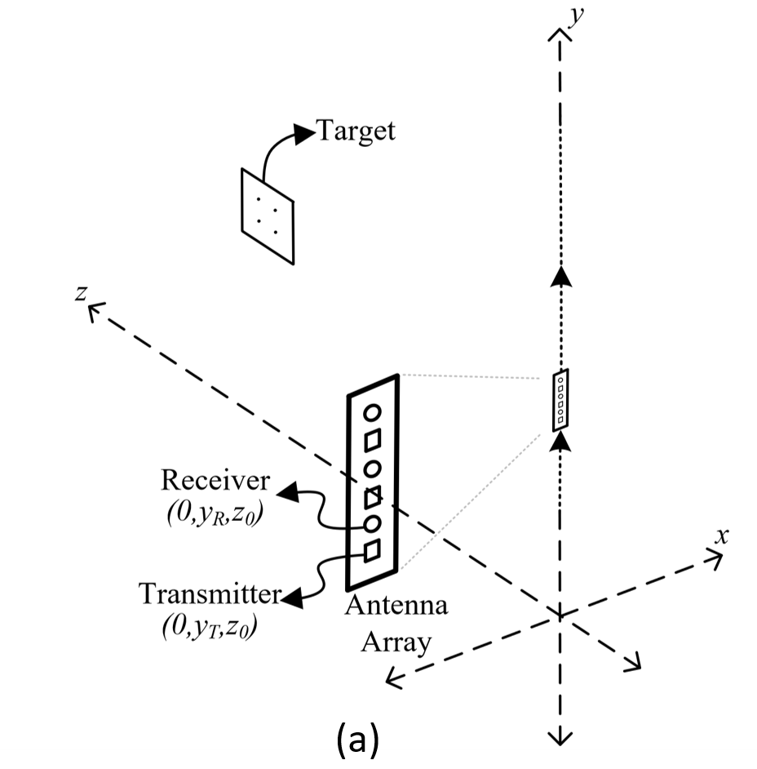
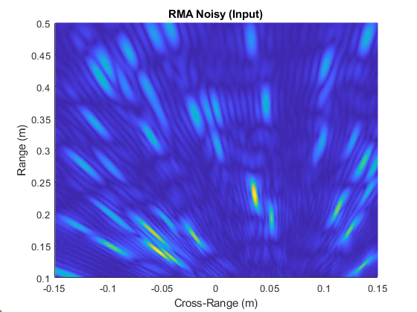
2D SAR Imaging
2D Imaging SAR Scanning
Linear scanning pattern
2D target
Recover image using range migration algorithm
Near-field beamformer
Resulting raw image is blurry and distorted
Raw RMA Image

Slide 16
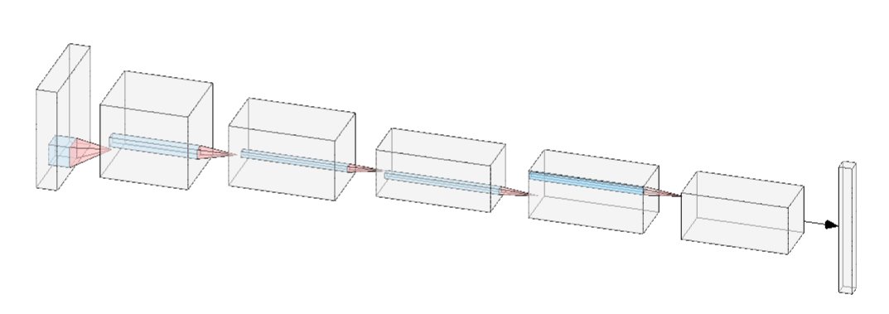
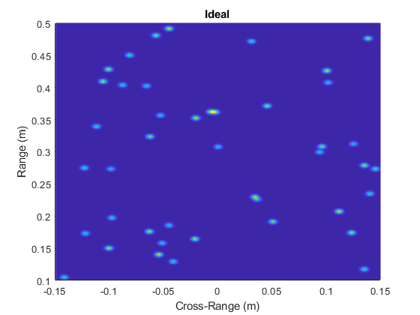
Proposed ML Solution
Convolutional Neural Network
Learns spatial features
Highly effective on structured images
Supervised learning
Synthetically generated features and labels (randomly placed points)
Training Features:
Image of randomly placed point targets recovered using RMA
Training Labels:
Corresponding ideal image. Each point target treated as narrow 2-D Gaussian pulse

Slide 17
Proposed ML Solution
The network will learn to remove the distortion from each RMA image to its corresponding ideal image
CNN learns and removes distortions (improves resolution)
Limited aperture effects, spherical wave approximation, limited bandwidth, path loss, etc.
Features: Raw Distorted Images
Labels: High Resolution Images
Image Enhancement CNN

Slide 18
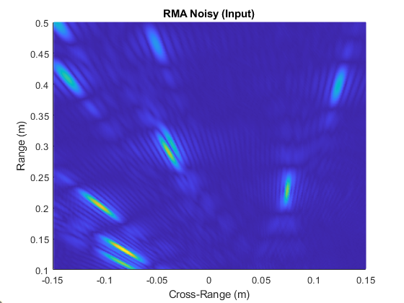
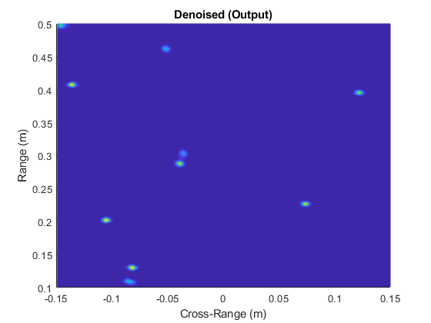
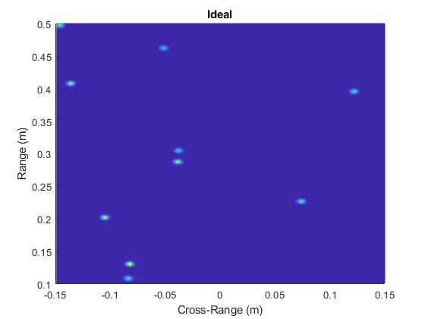
Results – Random Points
The algorithm has never seen this target before

Slide 19
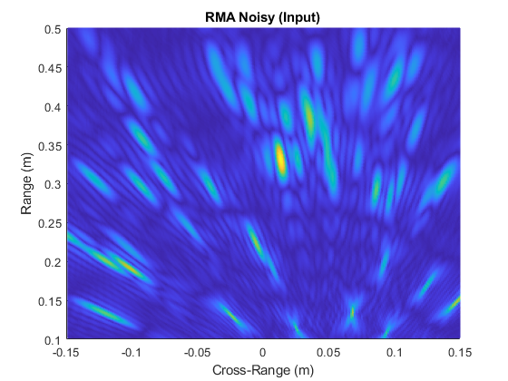
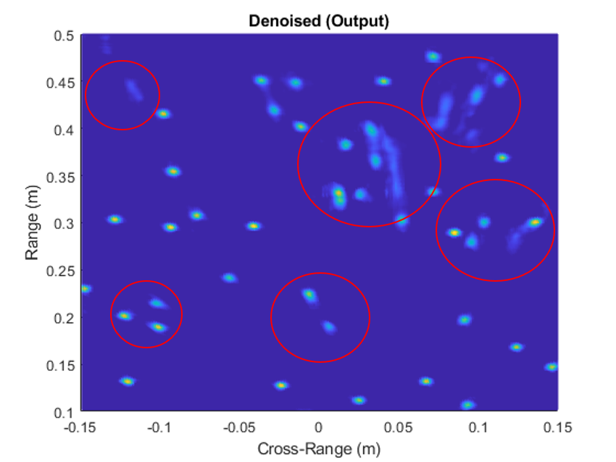
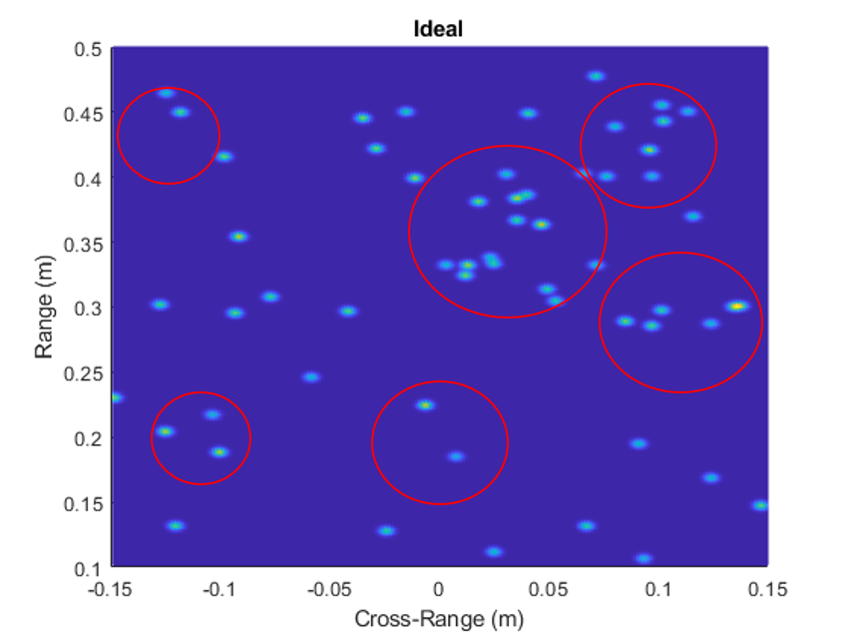
Results – Random Points
The algorithm has never seen this target before

Slide 20
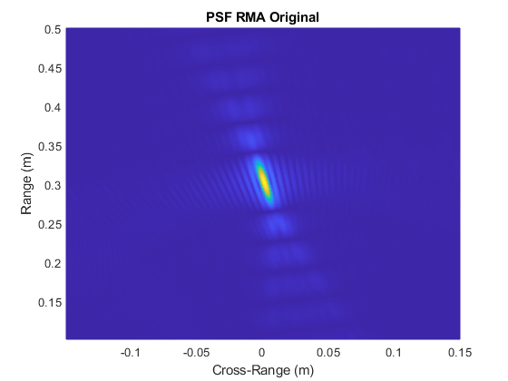
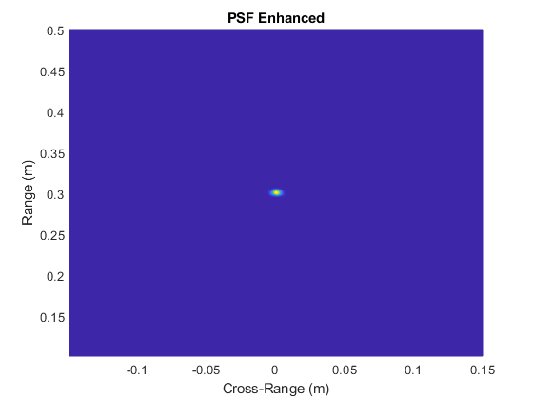
Results – Point Spread Function (PSF)
The algorithm has never seen this target before

Slide 21
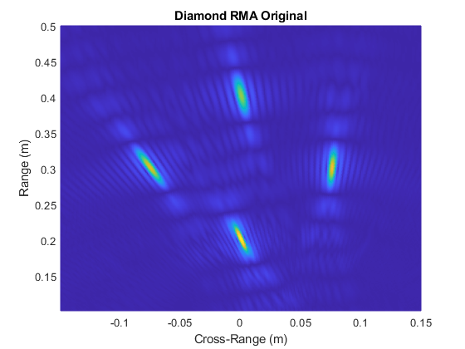
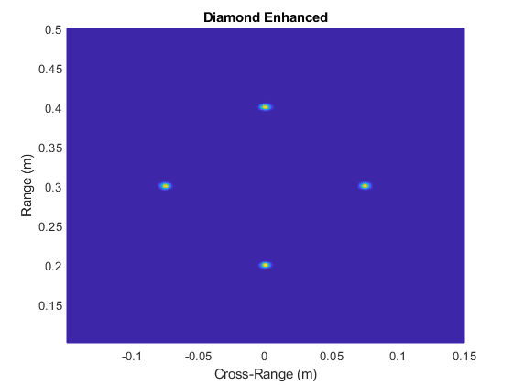
Results – Diamond
The algorithm has never seen this target before

Slide 22
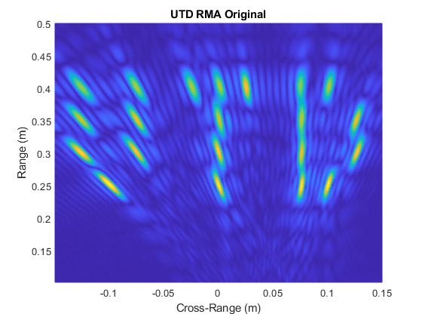
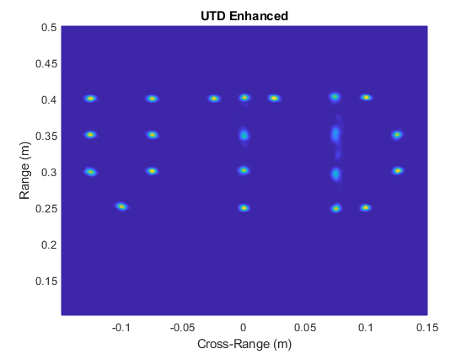
Results – UTD
The algorithm has never seen this target before

Slide 23
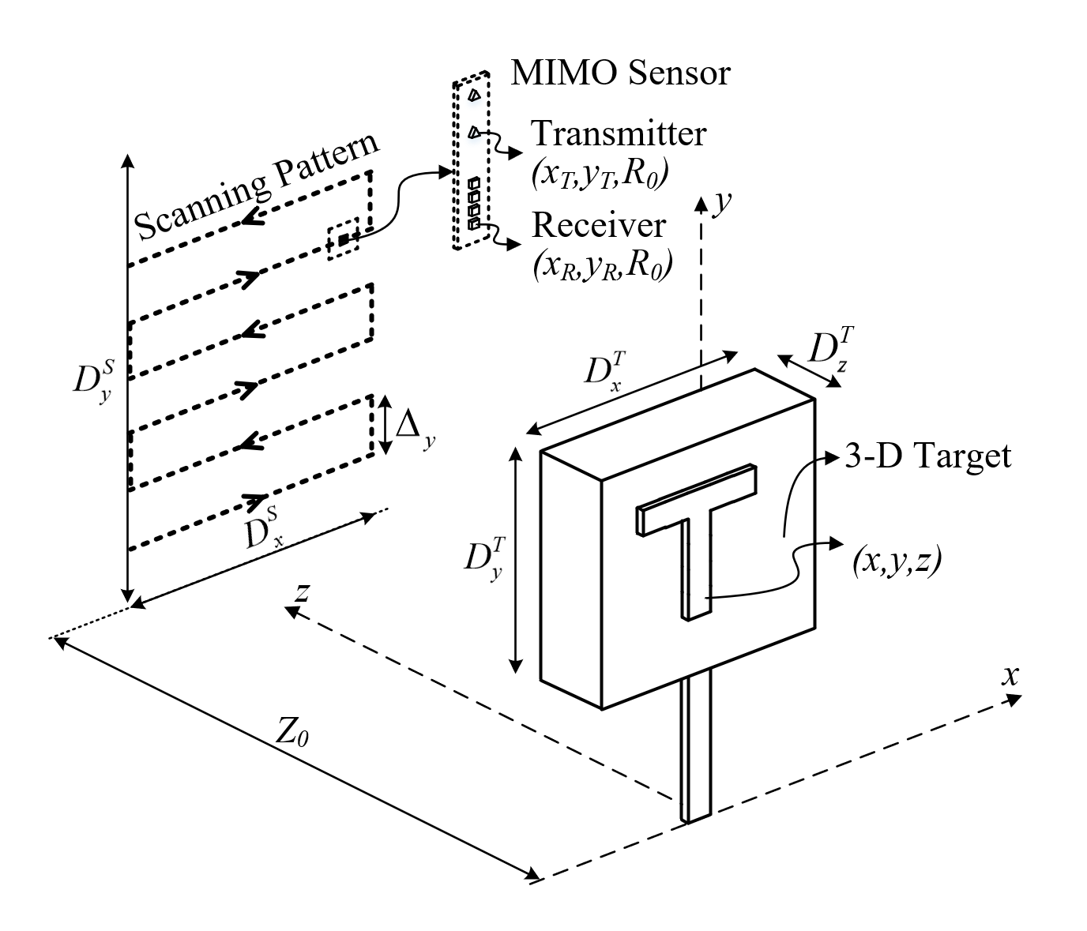
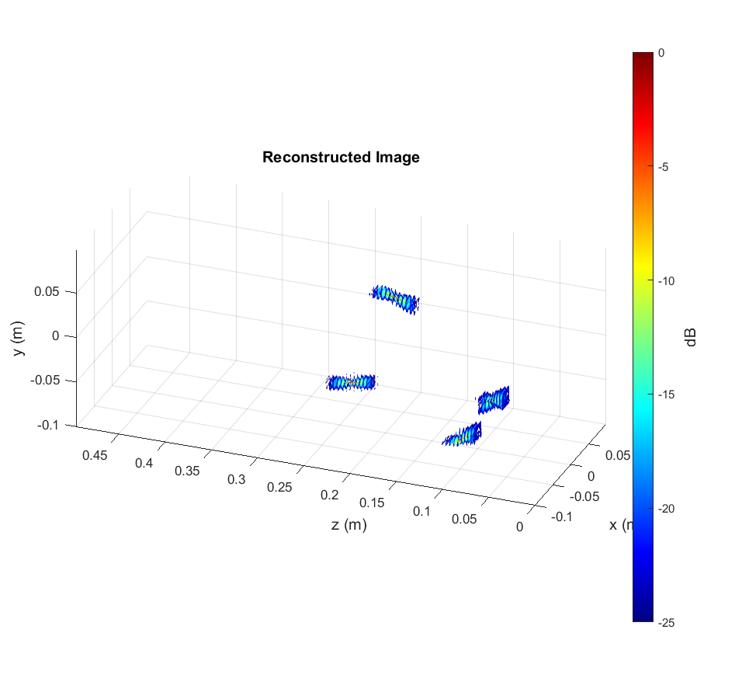
3D SAR Imaging
3D Imaging SAR Scanning
Rectangular scanning pattern
3D target
Random points + solid objects

Slide 24
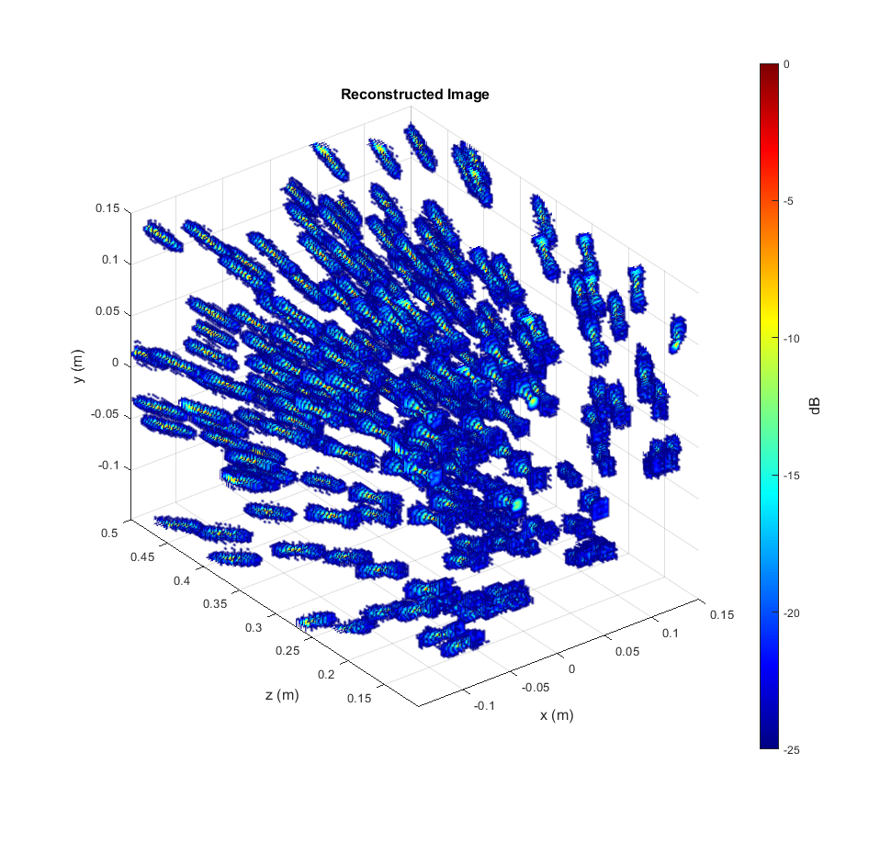
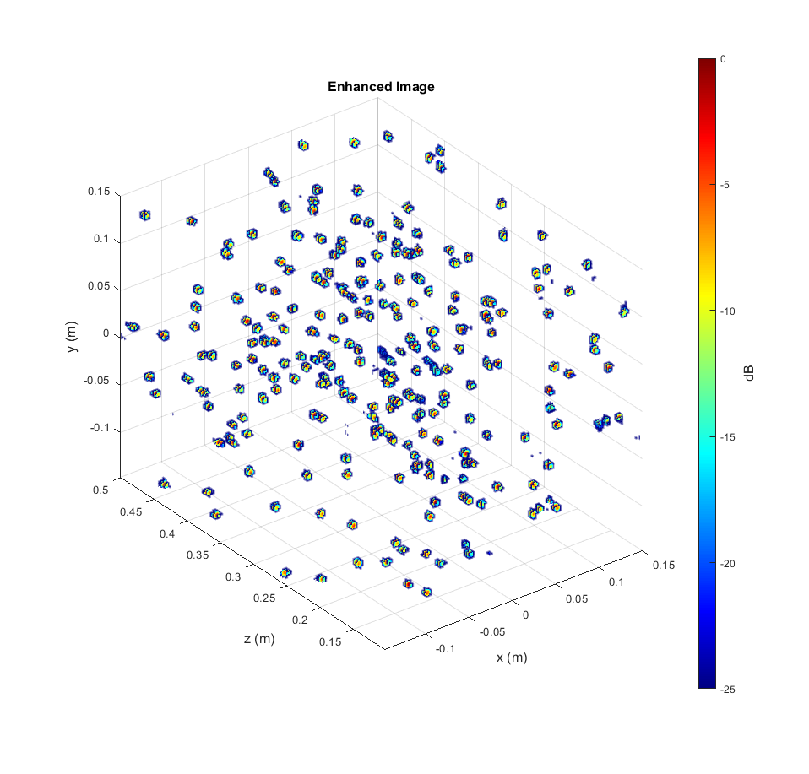
Results – Random Points
The algorithm has never seen this target before

Slide 25
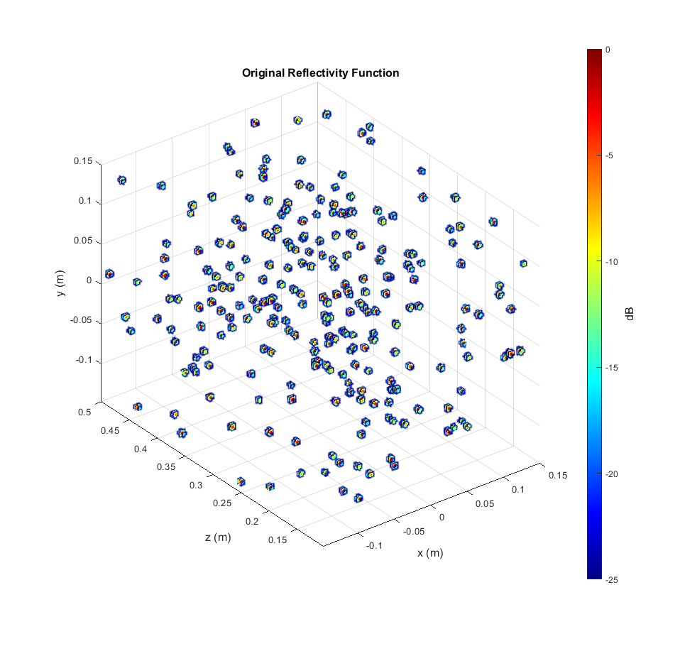
Results – Random Points
The algorithm has never seen this target before

Slide 26
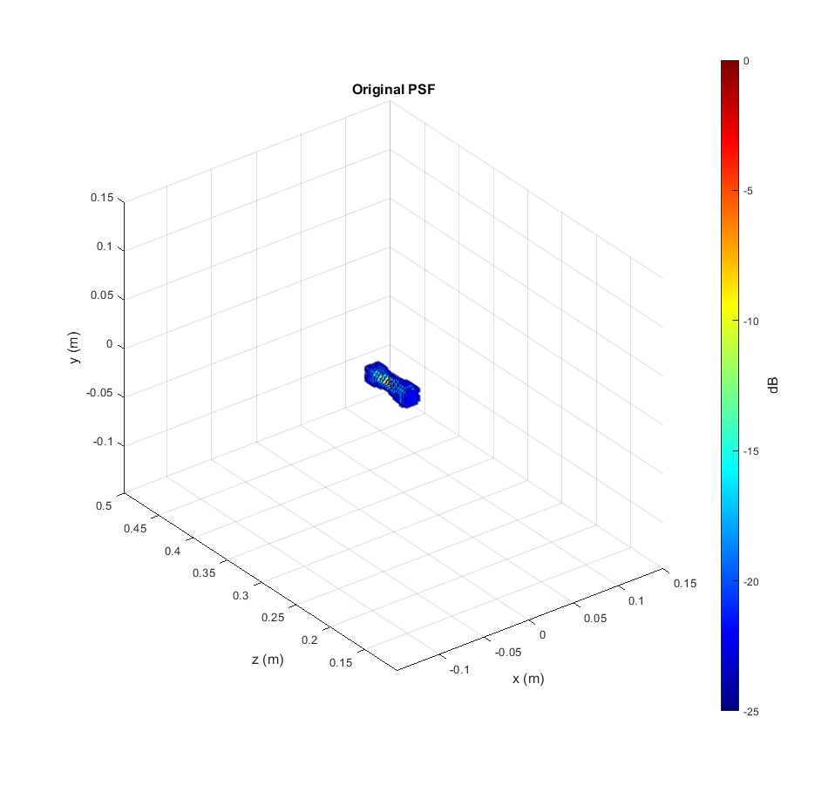
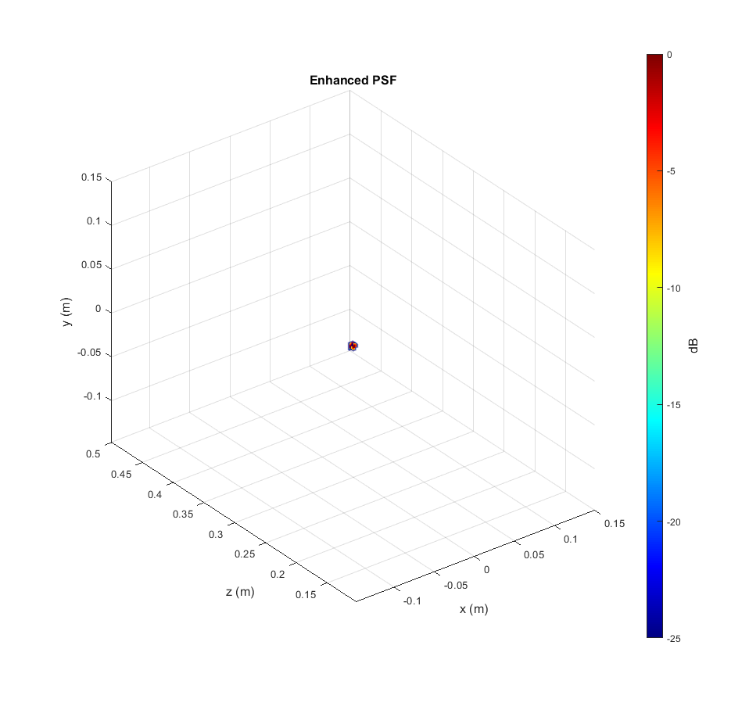
Results – PSF
The algorithm has never seen this target before

Slide 27
Results – PSF Comparison
The algorithm has never seen this target before

Slide 28
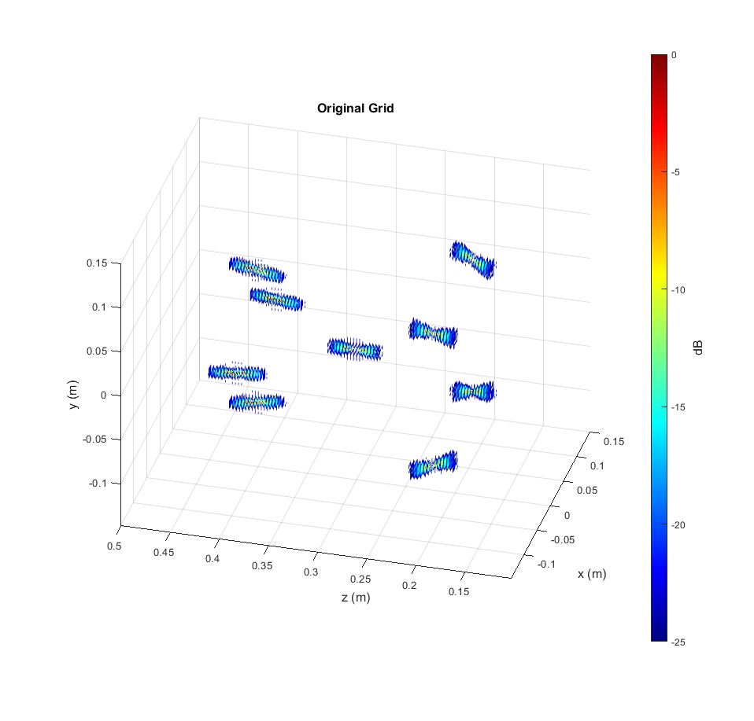
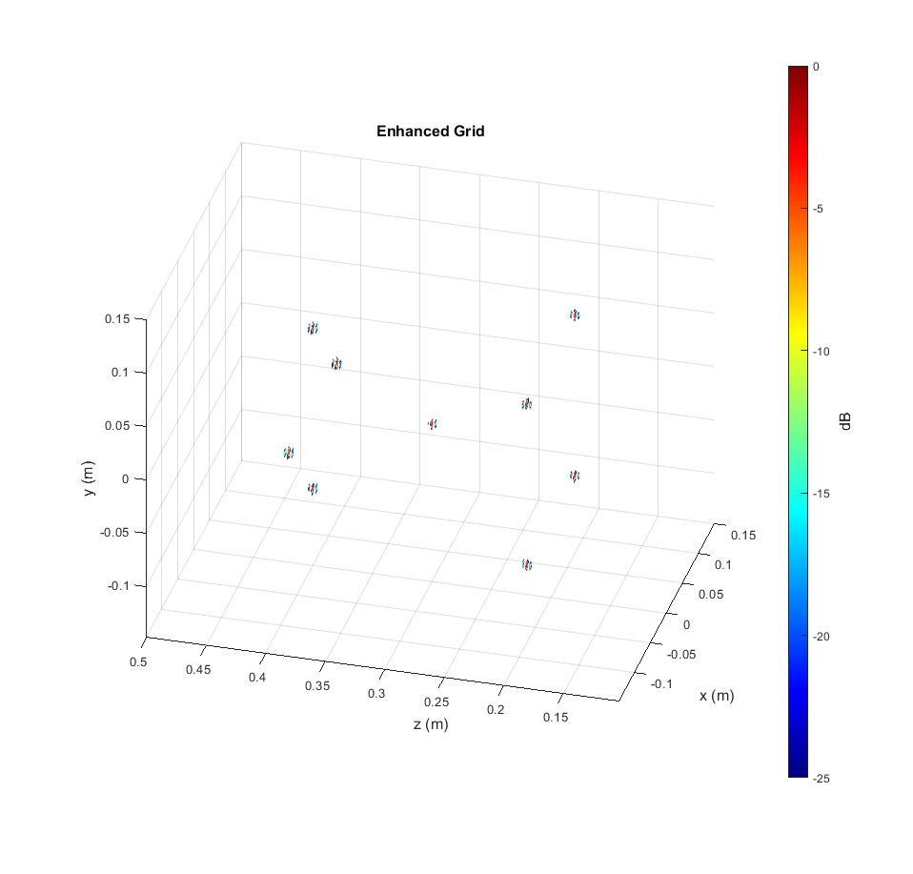
Results – Grid of Points
The algorithm has never seen this target before

Slide 29
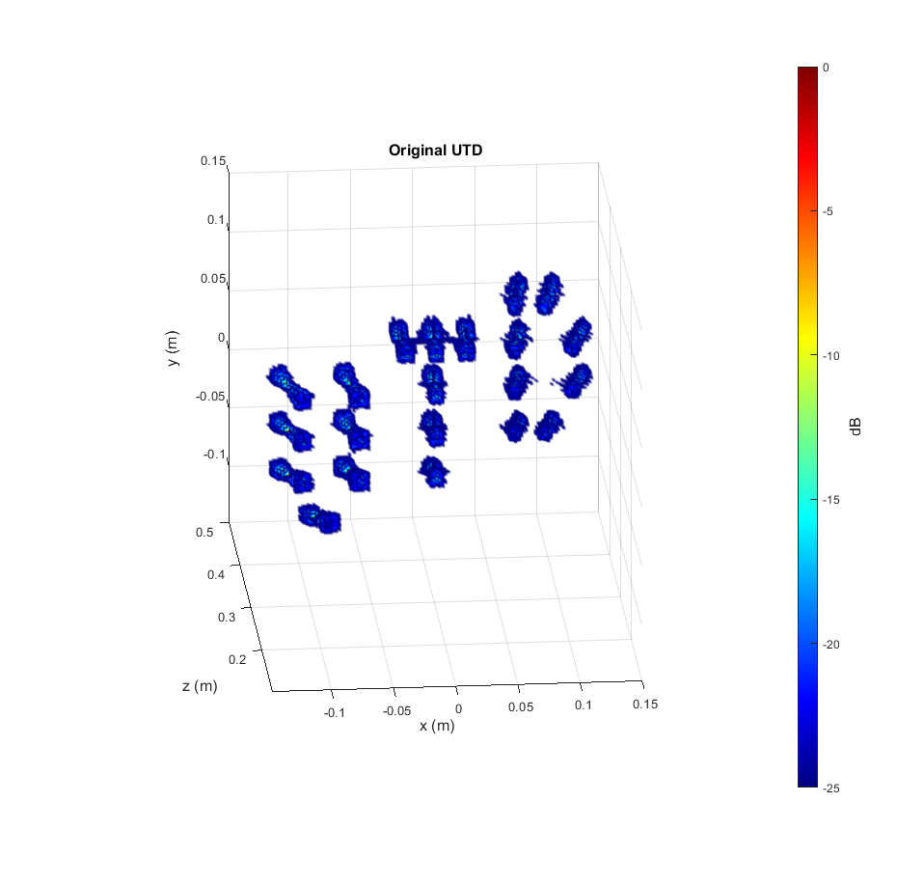
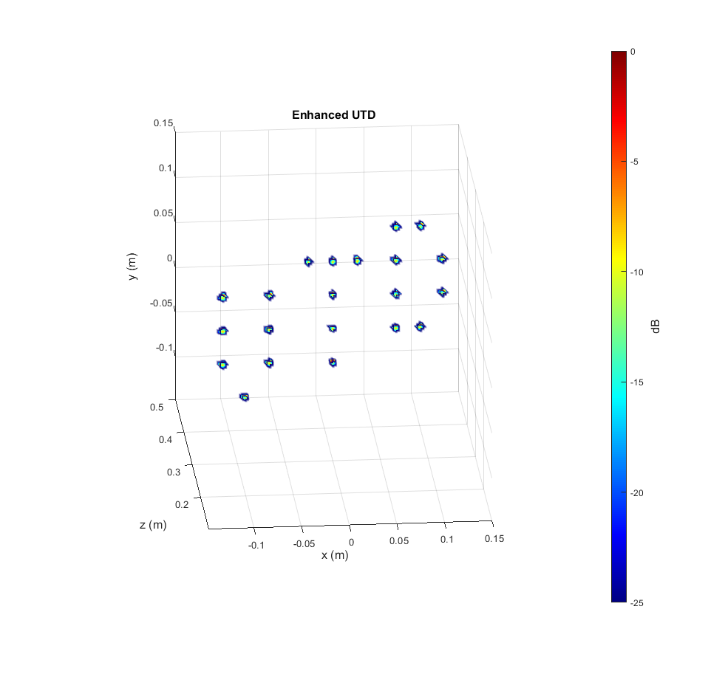
Results – UTD
The algorithm has never seen this target before

Slide 30
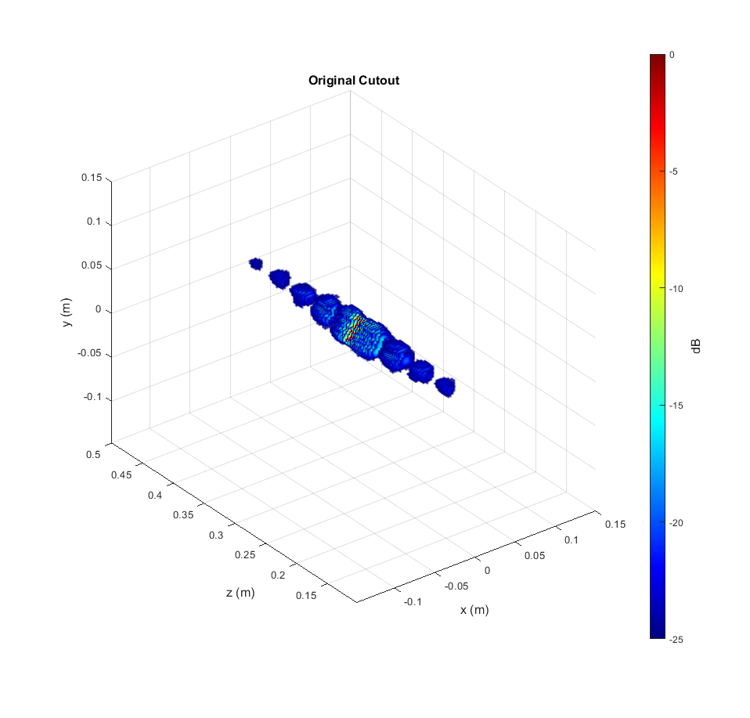
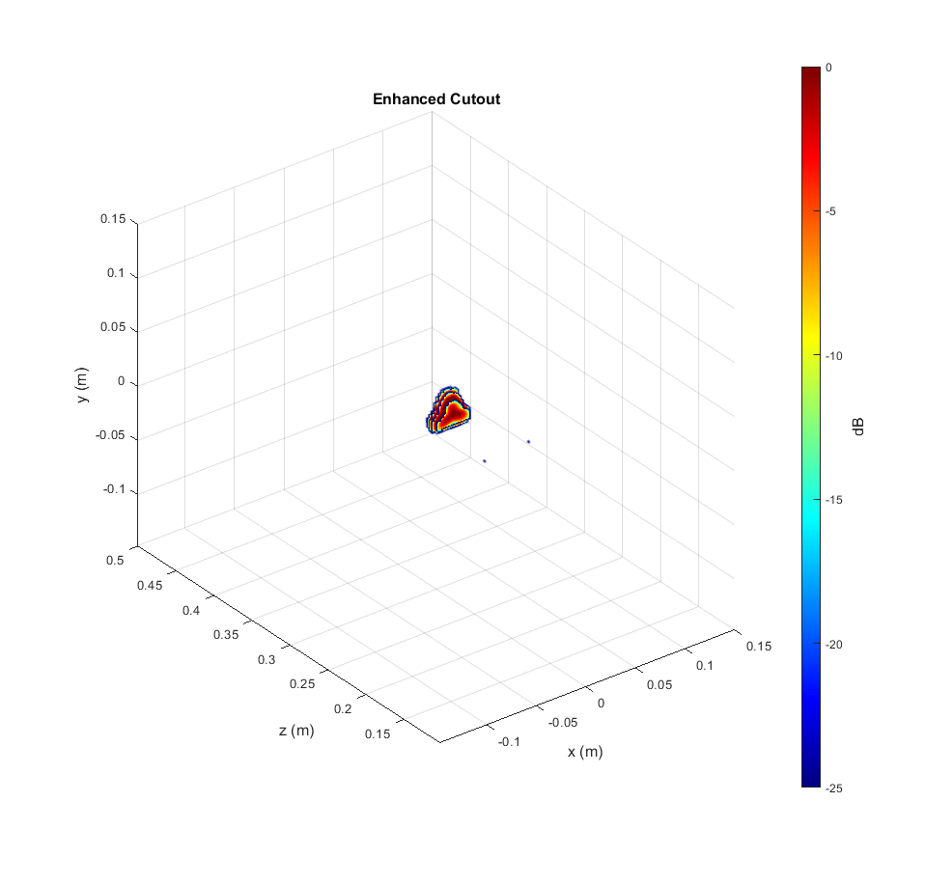
Results – Triangle
The algorithm has never seen this target before

Slide 31
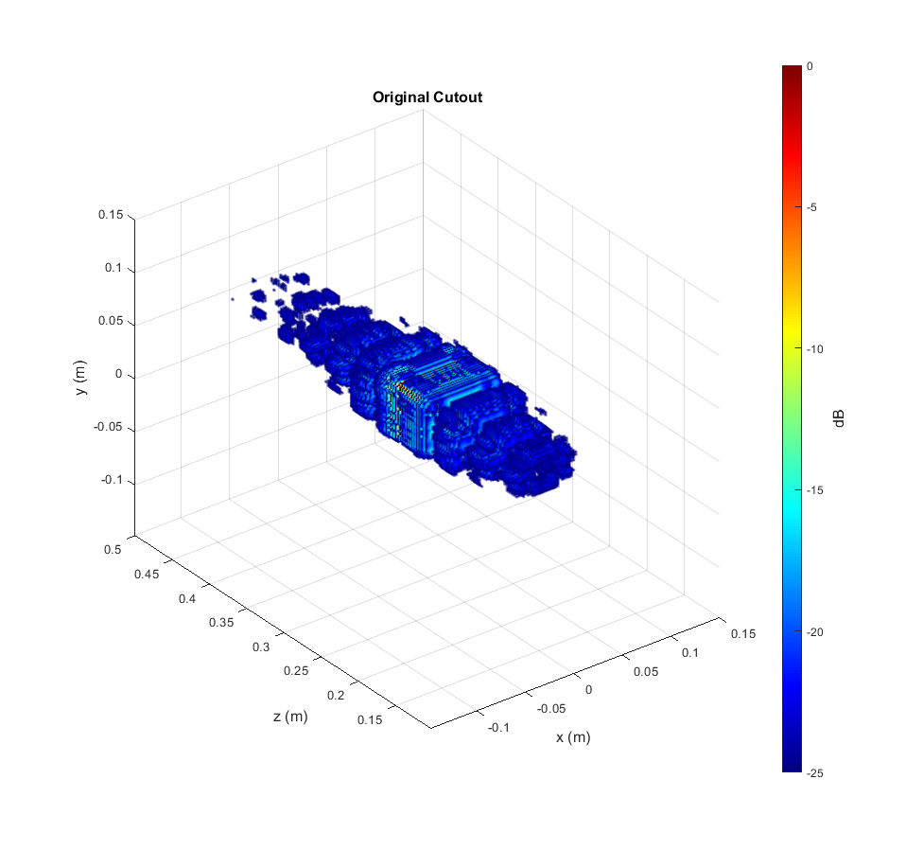
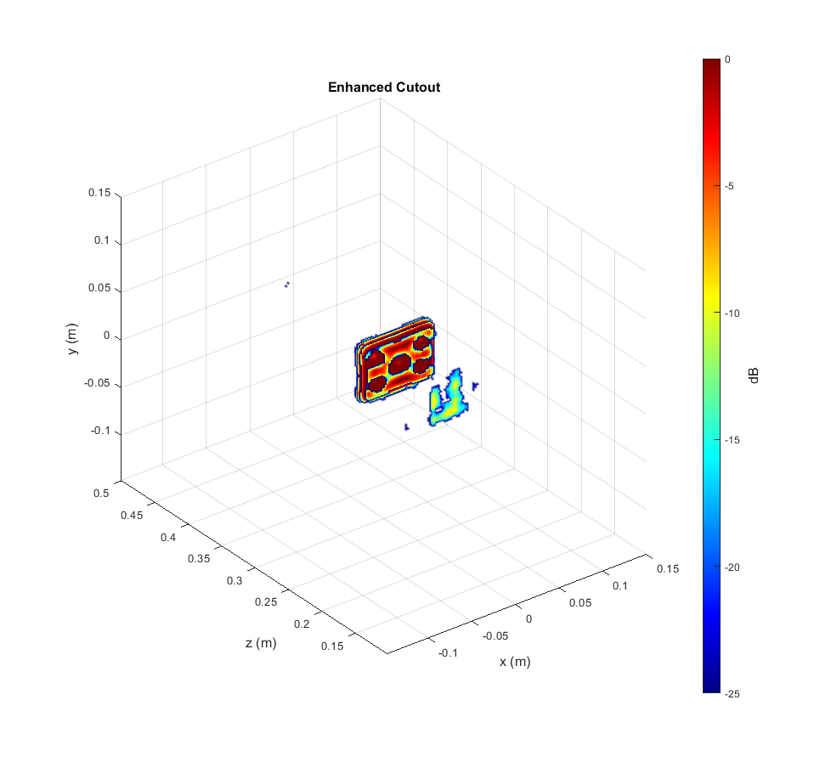

Results – Cutout
The algorithm has never seen this target before

Slide 32

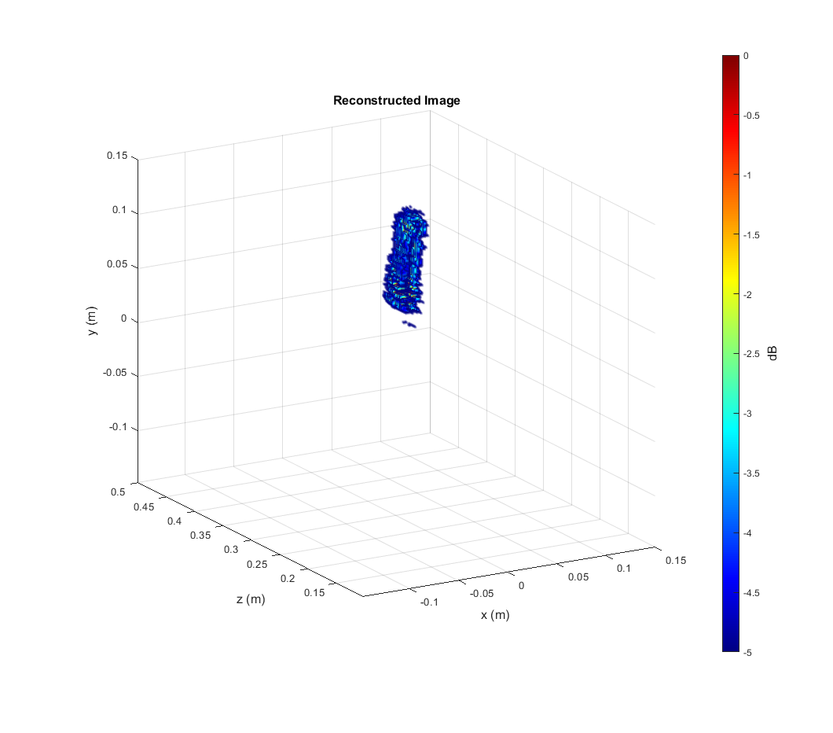
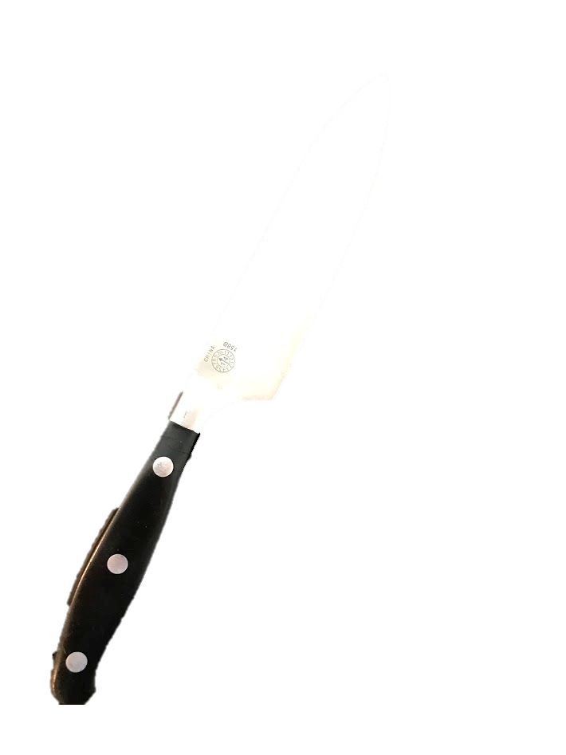
Empirical Results - Knife
Threshold at 5 dB
The algorithm has never seen this target before

Slide 33
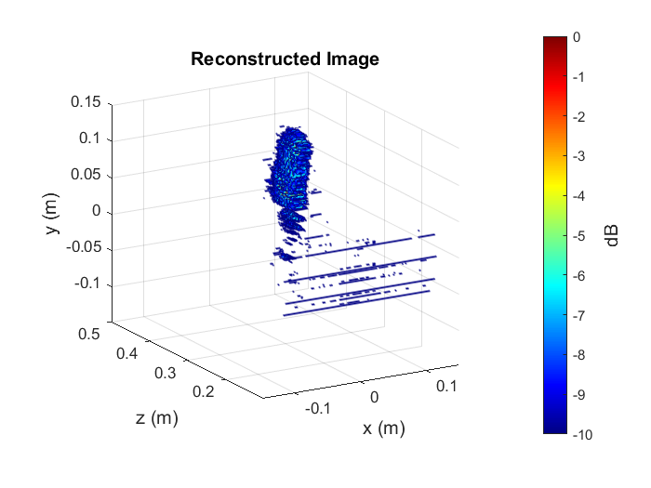
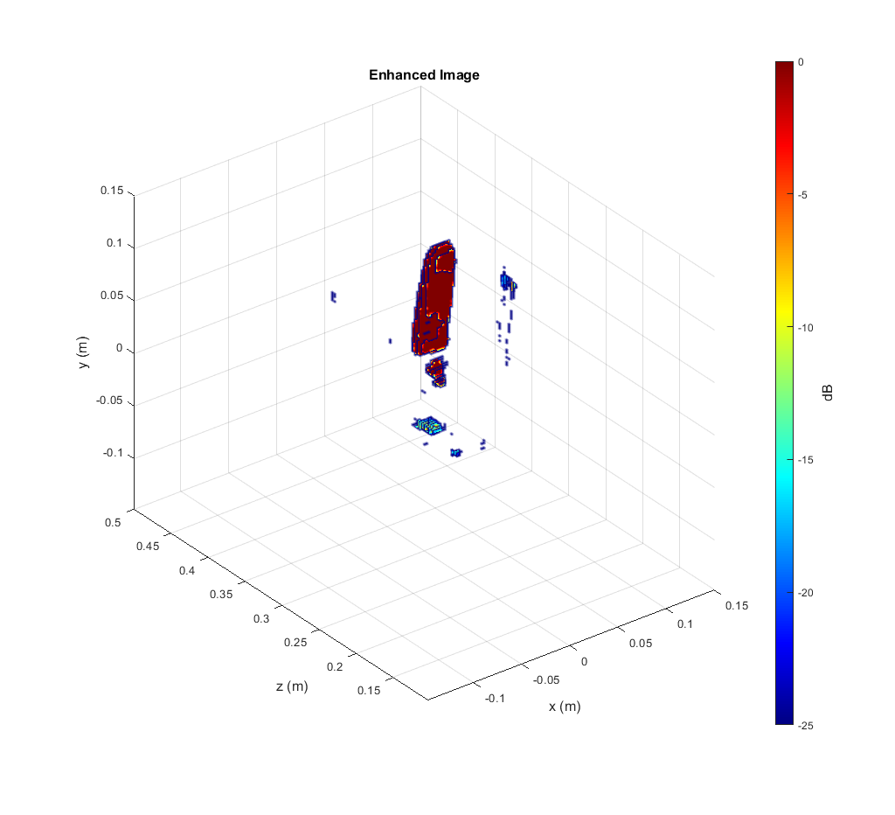
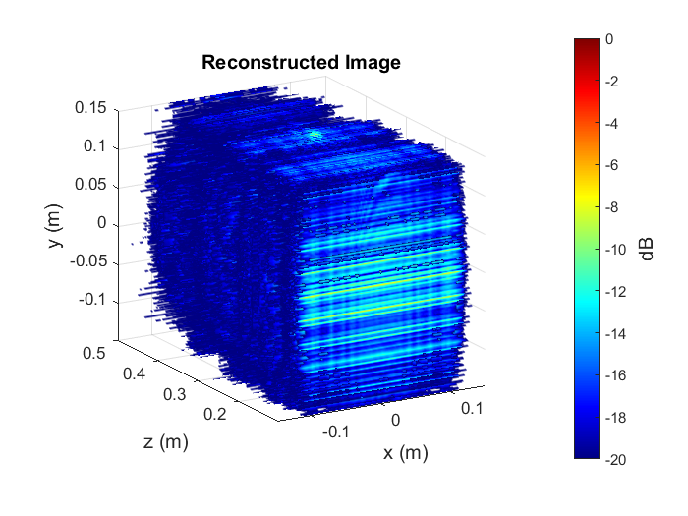
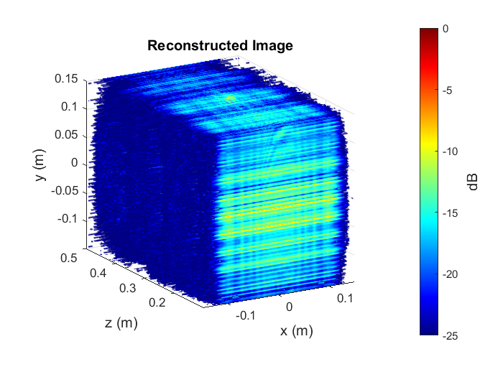
Empirical Results - Knife
5 dB
10 dB
Metal Dots in the handle are now shown (notice dynamic range 25dB)
- Considerable denoising is achieved
20 dB
25 dB
The algorithm has never seen this target before

Slide 34
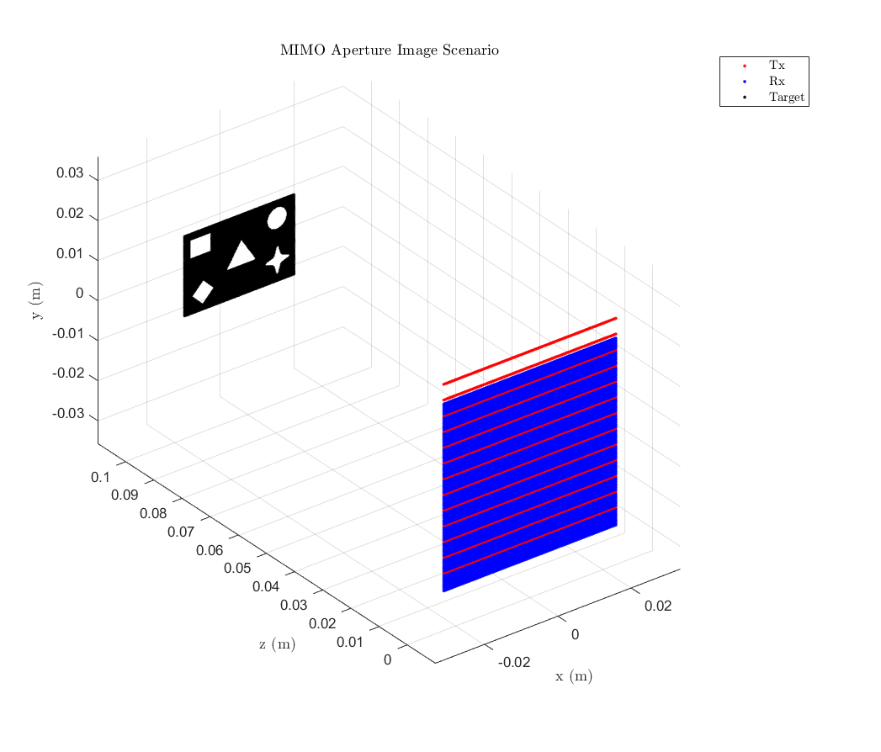
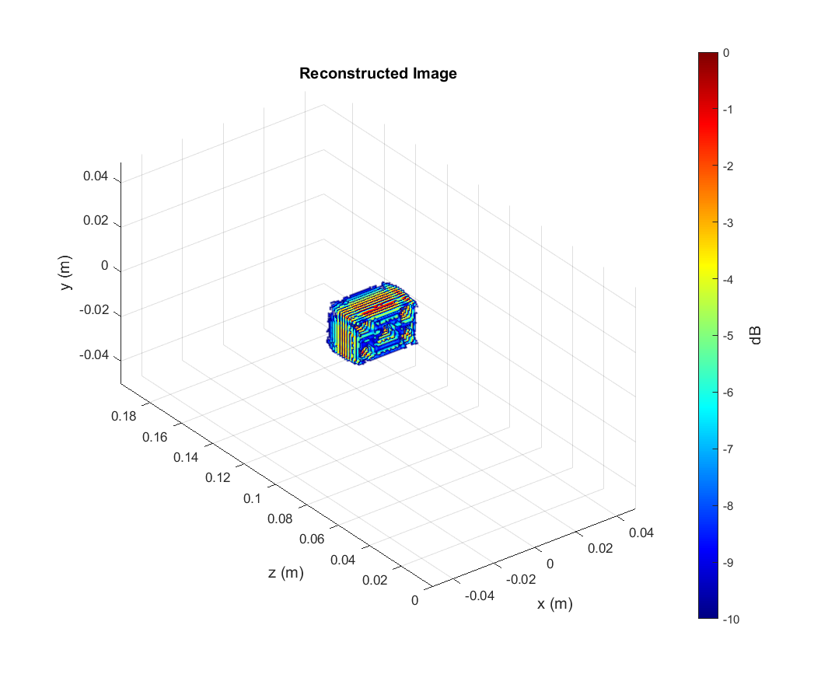
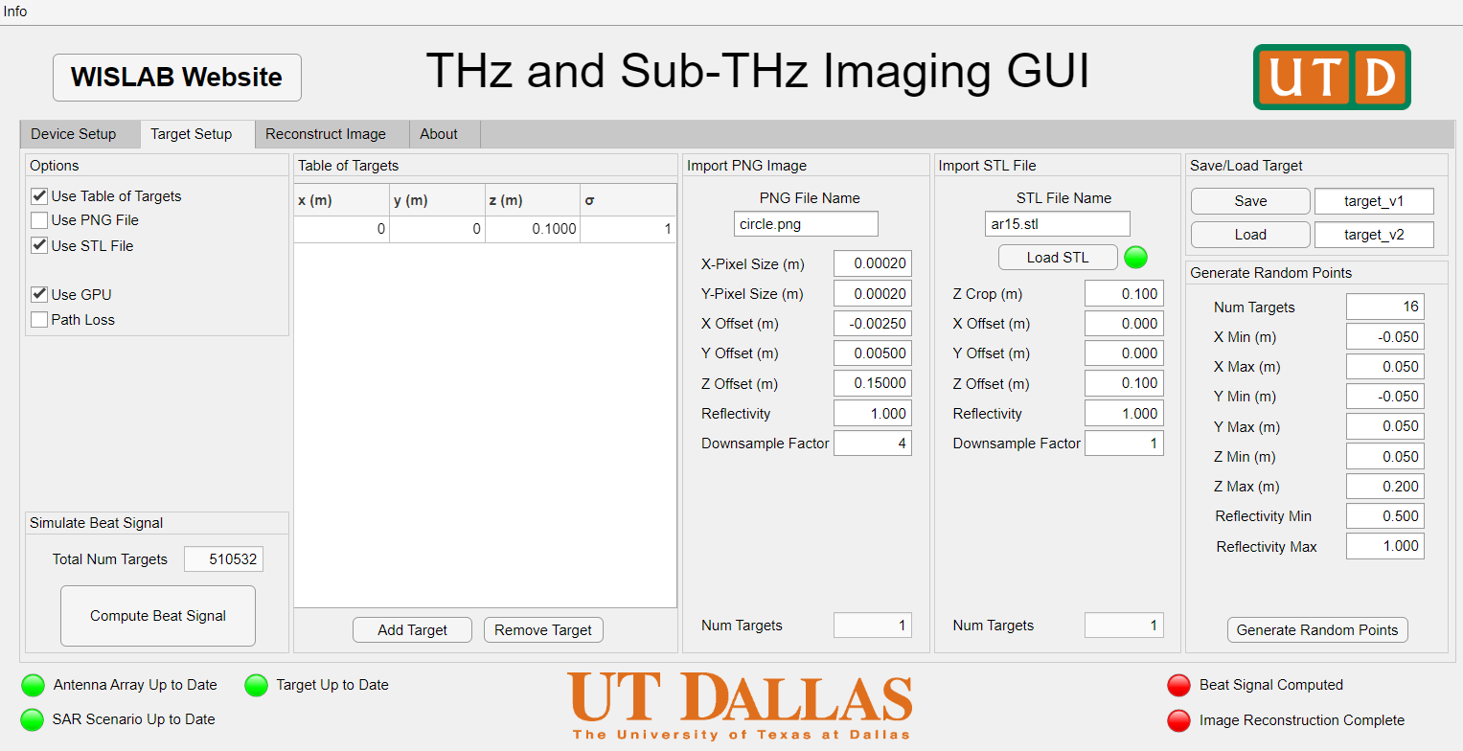
Data Generation – Synthetic Data
SAR image simulation pipeline
Interactive GUI
Efficient dataset generation
Flexible for any scanning mode
Journal paper on simulation pipeline in progress

Slide 35




Data Generation – Simulation Software
Waveform + Array + Scan Setup
Target + Simulation Setup

Slide 36

Data Generation – Synthetic Data
Introduce array position error in simulation algorithm
Simulate scanner position ambiguity

Slide 37



Data Generation – Synthetic Data
Array position error
Some point targets are ill-resolved
Lost definition of shapes

Slide 38

CNN Results – No Position Error
The algorithm has never seen this target before

Slide 39

CNN Results – With Position Error
The algorithm has never seen this target before

Slide 40






Data Generation – Real SAR Images

Slide 41
THz Imager

